Slide 1
Performance Estimation

Slide 2
ROC Curves

Slide 3
ROC Curves
ROC is an abbreviation of Receiver Operating Characteristic come from the signal detection theory, developed during World War 2 for analysis of radar images.
In the context of classifier, ROC plot is a useful tool to study the behaviour of a classifier or comparing two or more classifiers.
A ROC plot is a two-dimensional graph, where, X-axis represents FP rate (FPR) and Y-axis represents TP rate (TPR).
Since, the values of FPR and TPR varies from 0 to 1 both inclusive, the two axes thus from 0 to 1 only.
Each point (x, y) on the plot indicating that the FPR has value x and the TPR value y.

Slide 4
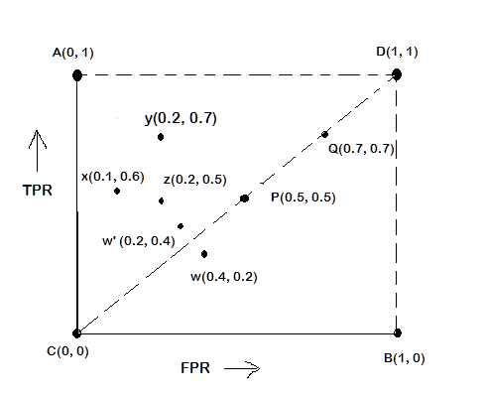
ROC Plot
A typical look of ROC plot with few points in it is shown in the following figure.
Note the four cornered points are the four extreme cases of classifiers
Identify the four extreme classifiers.

Slide 5
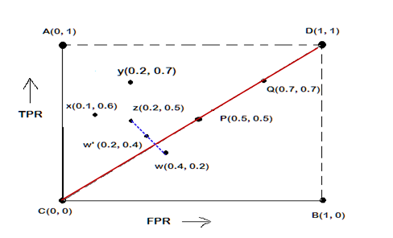
Interpretation of Different Points in ROC Plot
Le us interpret the different points in the ROC plot.
The four points (A, B, C, and D)
A: TPR = 1, FPR = 0, the ideal model, i.e., the perfect classifier, no false results
B: TPR = 0, FPR = 1, the worst classifier, not able to predict a single instance
C: TPR = 0, FPR = 0, the model predicts every instance to be a Negative class, i.e., it is an ultra-conservative classifier
D: TPR = 1, FPR = 1, the model predicts every instance to be a Positive class, i.e., it is an ultra-liberal classifier

Slide 6
Interpretation of Different Points in ROC Plot
Le us interpret the different points in the ROC plot.
The points on diagonals
The diagonal line joining point C(0,0) and D(1,1) corresponds to random guessing
Random guessing means that a record is classified as positive (0r negative) with a certain probability
Suppose, a test set contacting N₊ positive and N₋ negative instances. Suppose, the classifier guesses any instances with probability p
Thus, the random classifier is expected to correctly classify p.N₊ of the positive instances and p.N₋ of the negative instances
Hence, TPR = FPR = p
Since TPR = FPR, the random classifier results reside on the main diagonals

Slide 7
Interpretation of Different Points in ROC Plot
Let us interpret the different points in the ROC plot.
The points on the upper diagonal region
All points, which reside on upper-diagonal region are corresponding to classifiers “good” as their TPR is as good as FPR (i.e., FPRs are lower than TPRs)
Here, X is better than Z as X has higher TPR and lower FPR than Z.
If we compare X and Y, neither classifier is superior to the other

Slide 8
Interpretation of Different Points in ROC Plot
Let us interpret the different points in the ROC plot.
The points on the lower diagonal region
The Lower-diagonal triangle corresponds to the classifiers that are worst than random classifiers
Note: A classifier that is worst than random guessing, simply by reversing its prediction, we can get good results.
W’(0.2, 0.4) is the better version than W(0.4, 0.2), W’ is a mirror reflection of W

Slide 9
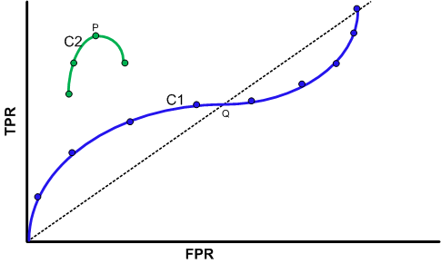
Tuning a Classifier through ROC Plot
Using ROC plot, we can compare two or more classifiers by their TPR and FPR values and this plot also depicts the trade-off between TPR and FPR of a classifier.
Examining ROC curves can give insights into the best way of tuning parameters of classifier.
For example, in the curve C2, the result is degraded after the point P. Similarly for the observation C1, beyond Q the settings are not acceptable.

Slide 10
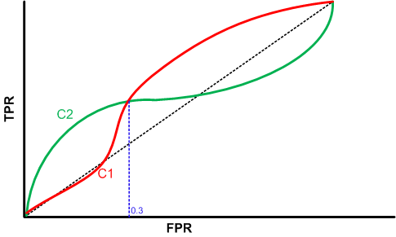
Comparing Classifiers trough ROC Plot
Two curves C1 and C2 are corresponding to the experiments to choose two classifiers with their parameters.
Here, C1 is better than C2 when FPR is less than 0.3.
However, C2 is better, when FPR is greater than 0.3.
Clearly, neither of these two classifiers dominates the other.

Slide 11
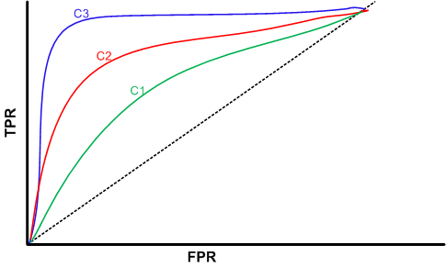
Comparing Classifiers trough ROC Plot
We can use the concept of “area under curve” (AUC) as a better method to compare two or more classifiers.
If a model is perfect, then its AUC = 1.
If a model simply performs random guessing, then its AUC = 0.5
A model that is strictly better than other, would have a larger value of AUC than the other.
Here, C3 is best, and C2 is better than C1 as AUC(C3)>AUC(C2)>AUC(C1).

Slide 12
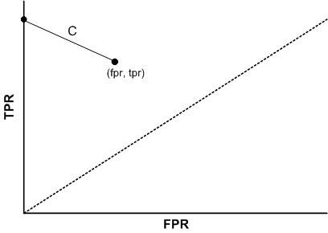
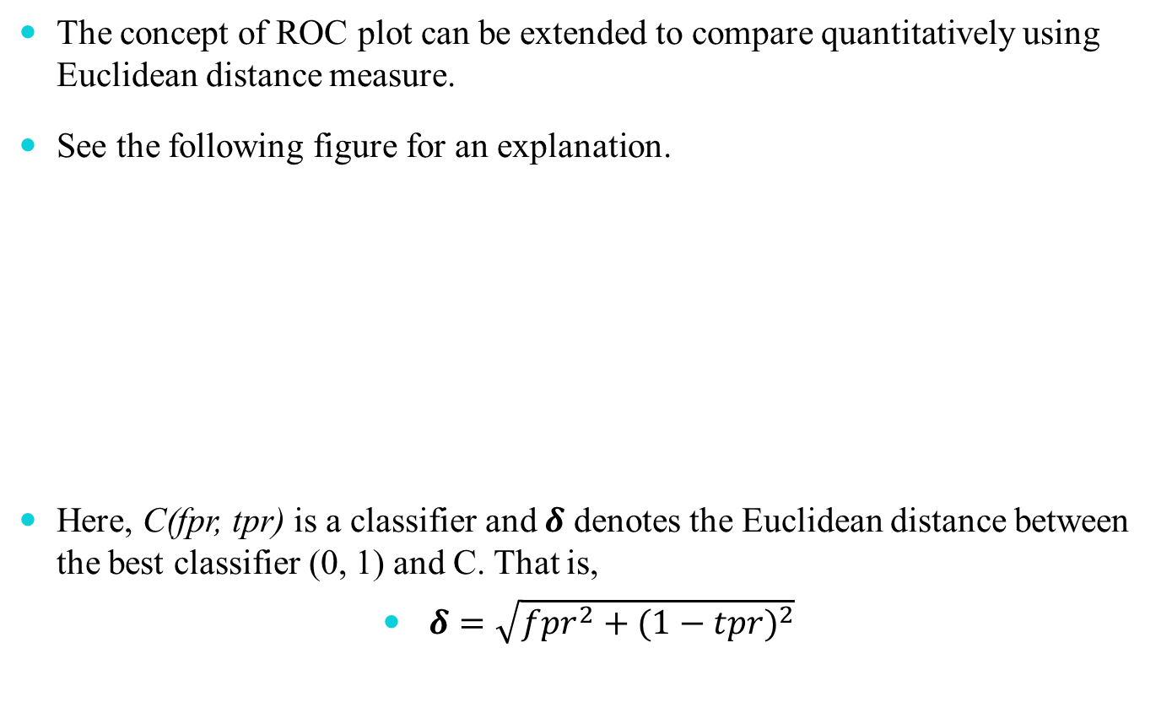
A Quantitative Measure of a Classifier
The concept of ROC plot can be extended to compare quantitatively using Euclidean distance measure.
See the following figure for an explanation.
Here, C(fpr, tpr) is a classifier and $δ$ denotes the Euclidean distance between the best classifier (0, 1) and C. That is,
$δ=\sqrt{{fpr}^{2}+{(1−tpr)}^{2}}$

Slide 13
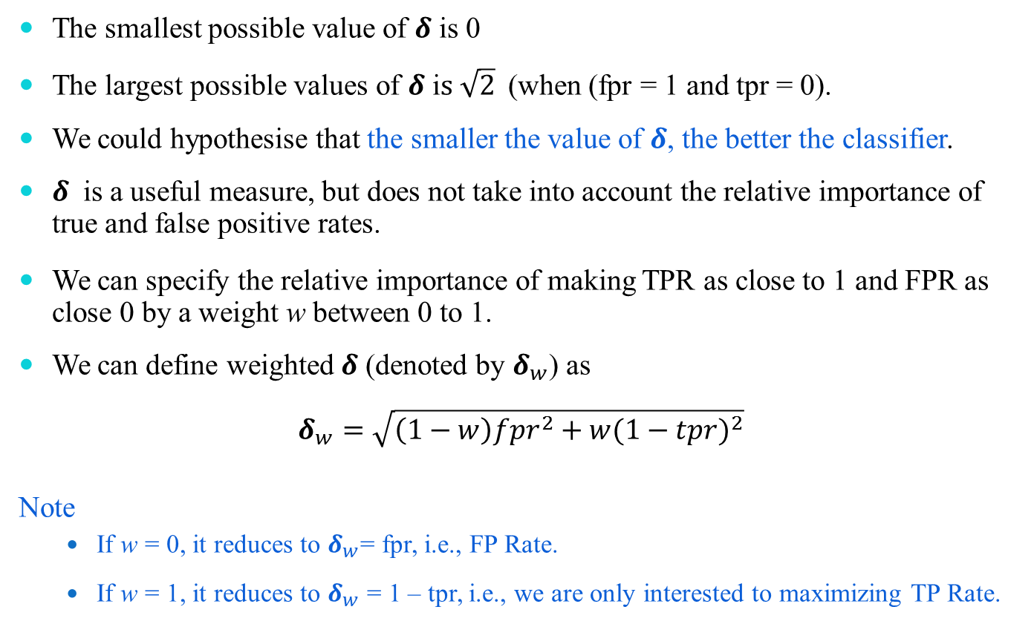
A Quantitative Measure of a Classifier
The smallest possible value of $δ$ is 0
The largest possible values of $δ$ i$s \sqrt{2}$(when (fpr = 1 and tpr = 0).
We could hypothesise that the smaller the value of $δ$, the better the classifier.
$δ$ is a useful measure, but does not take into account the relative importance of true and false positive rates.
We can specify the relative importance of making TPR as close to 1 and FPR as close 0 by a weight w between 0 to 1.
We can define weighted $δ$ (denoted by $δ_{w}$) as
$$δ_{w}=\sqrt{\left(1−w\right){fpr}^{2}+w{(1−tpr)}^{2}}$$
Note
If w = 0, it reduces to $δ_{w}$= fpr, i.e., FP Rate.
If w = 1, it reduces to $δ_{w}$ = 1 – tpr, i.e., we are only interested to maximizing TP Rate.

Slide 14
Reference
The detail material related to this lecture can be found in
Data Mining: Concepts and Techniques, (3rd Edn.), Jiawei Han, Micheline Kamber, Morgan Kaufmann, 2015.
Introduction to Data Mining, Pang-Ning Tan, Michael Steinbach, and Vipin Kumar, Addison-Wesley, 2014

Slide 15
Thank You

